Slide 1
US Census Income Analysis
Group 12: Sahar KHAN, Alex GRILL, Caroline SEARCY
Business question: Can we predict which individuals make over $50k in income to market for a $25 million direct marketing campaign.
Answer: Yes we can!

Slide 2
Executive Summary
Random Forest gives the most accurate prediction of households with an income > $50k
Most important variables for prediction:
Education
Marital Status
Occupation
Relationship
Who is our ideal customer? – We use the target customer characteristics to define marketing campaign
Married husband, Bachelors Education, Executive Managerial Occupation or Profession Specialty

Slide 3
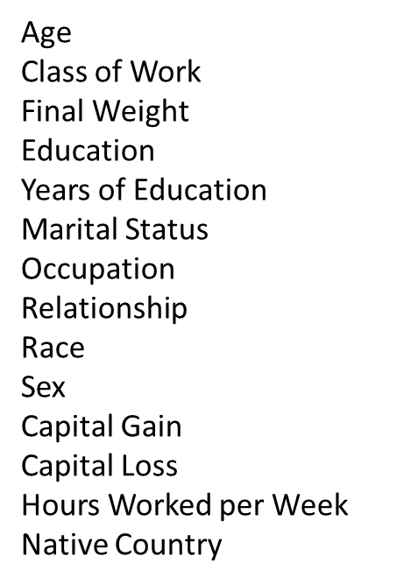
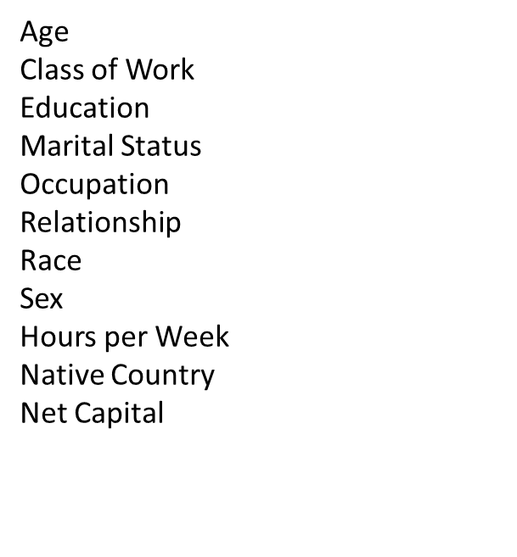
Predictor Variables
Original Dataset
Transformed Dataset
Used Final Weight to adjust/rescale data to be representative of the population
Removed Years of Education because it represented the same data as the Education column
Combined Capital Gain and Capital Loss into Net Capital

Slide 4
Data Cleaning: Missing values and outliers
Found outliers in Age, Hours per Week, and Net Capital, and set them to missing
Transposed the missing values in Age and Hours per Week with he means of the variables
Created Net Capital (binary variable) which represents data as two options: Capital Gain or No Impact/Loss

Slide 5
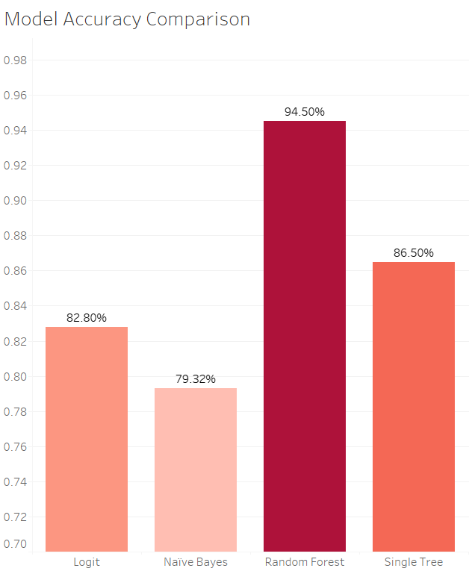
Random Forest model Significantly outperforms others
Stronger in 3 Quantifiable Metrics:
Accuracy Rate (94.5%)
True Positive Rate (92.6%)
False Positive Rate (5.0%)

Slide 6
Top 4 Important Variables
Significant factors in model:
Education
Marital Status
Occupation
Relationship

Slide 7
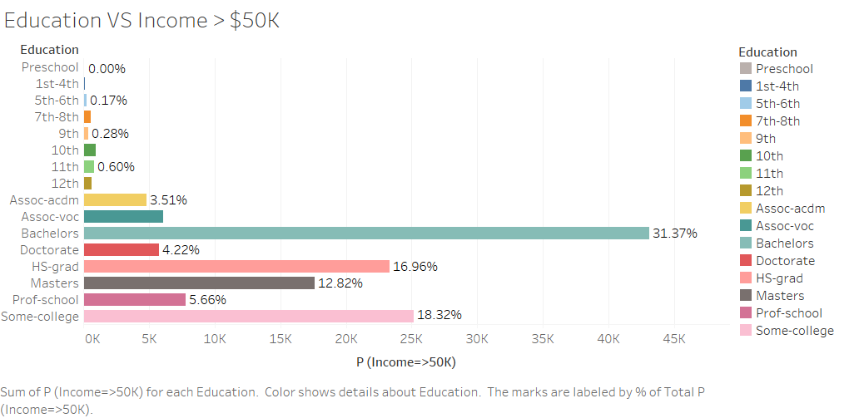
Education
HS grad, Bachelors and College students earn more

Slide 8
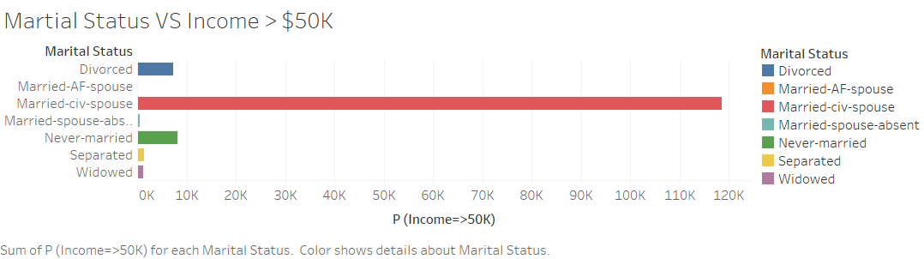
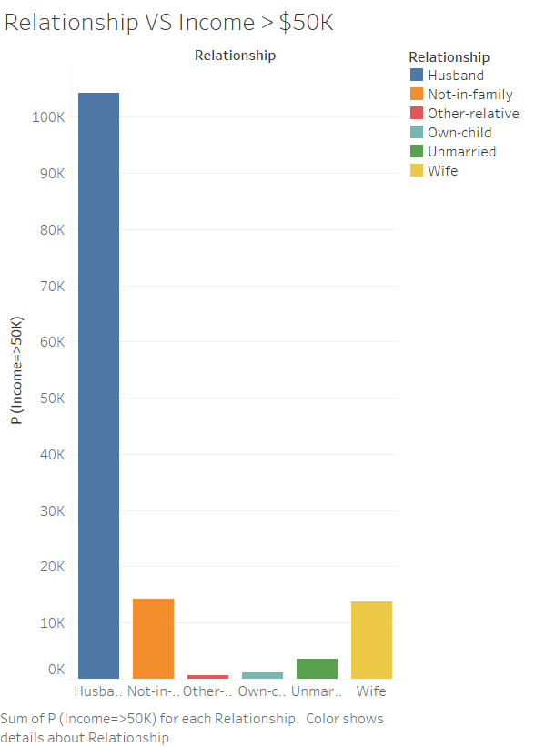
Marital Status and relationship
Prediction shows Married civilian Husbands earn the highest

Slide 9
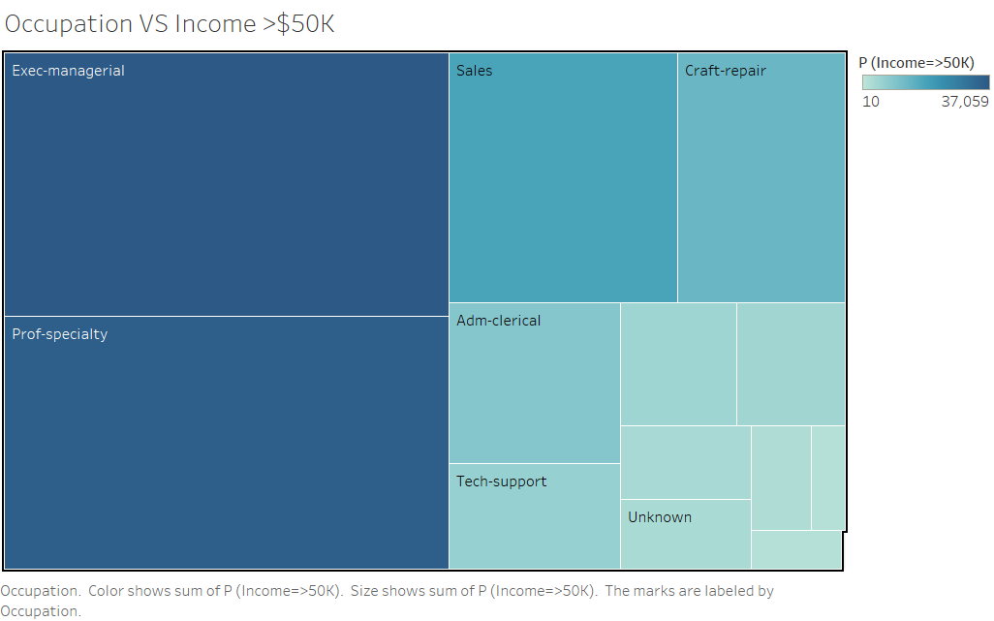
Occupation
People with Professional Specialty and Executive positions are the highest paid

Slide 10
Our ideal customer
Target Markets:
Relationship status: Married Husbands
Education: Bachelors
Occupation: Executive managerial and professional specialty

Slide 11

Conclusion
Recommendations:
1. Use a Random Forest model to get the best accuracy
2. Use ideal target customer characteristics to design campaign and its reach
3. Reevaluate the model after 6 months for further understanding of company’s position in the market

Slide 12
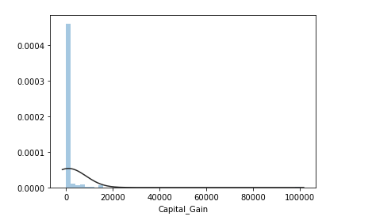
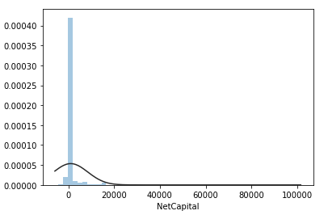
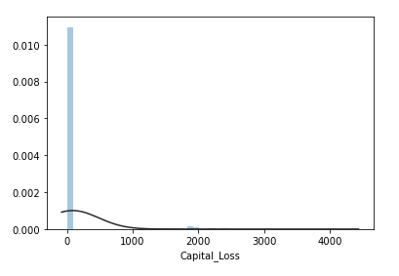
Appendix Data Distribution of Independent variables:
Grouped into Net Capital = Capital gain - Capital loss

Slide 13
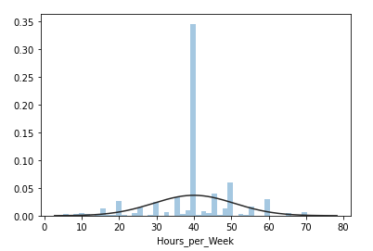
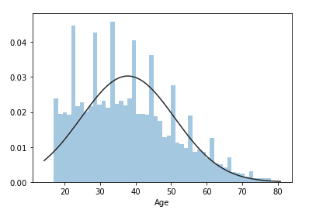
APPENDIX (CONT.) DATA DISTRIBUTION OF INDEPENDENT VARIABLES (CONT.):
We imputed outliers with interpolation nearest method.

Slide 14
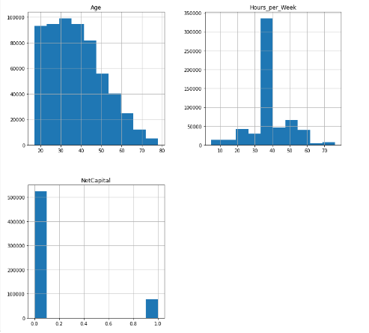
APENDIX (Cont.) histograms for numeric variables (Q8):

Slide 15
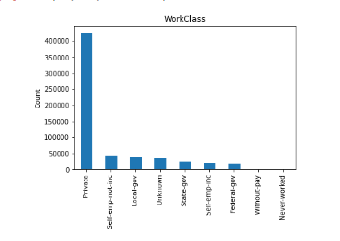
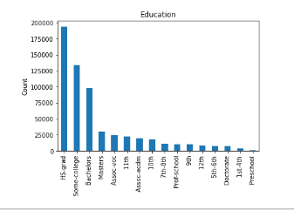
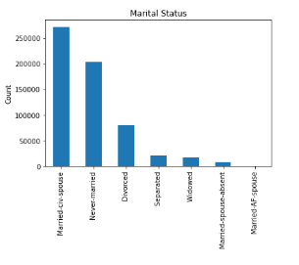
APENDIX (Cont.) bar chart for categorical variables (Q9):

Slide 16
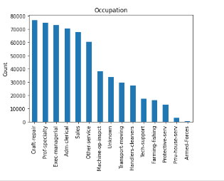
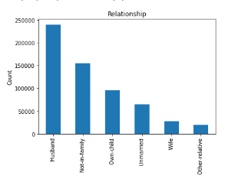
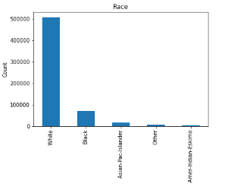
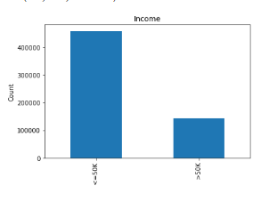
APENDIX (Cont.) bar chart for categorical variables (CONT.) (Q9):

Slide 17
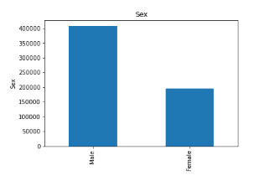
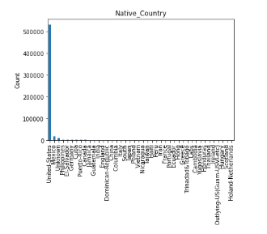
APENDIX (Cont.) bar chart for categorical variables (CONT.) (Q9):

Slide 18
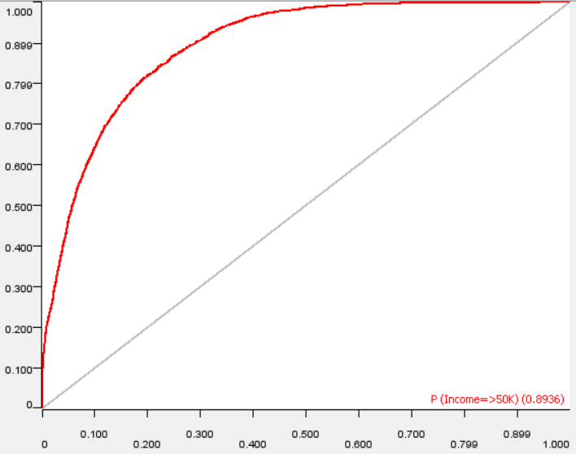
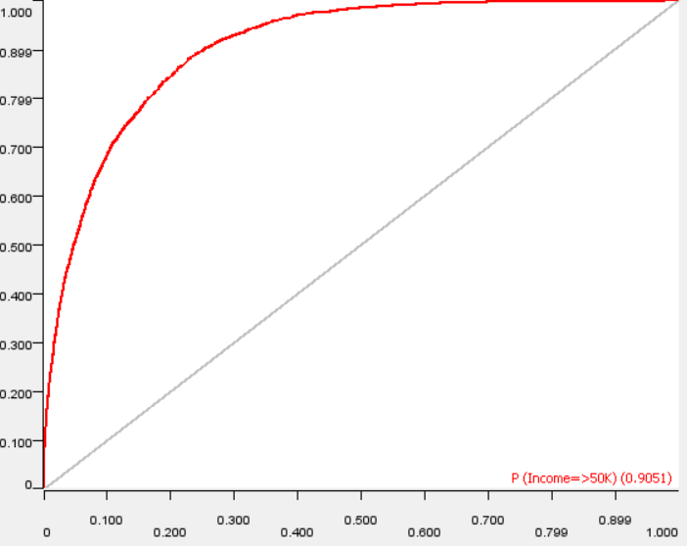
APENDIX (Cont.) ROC Curves (Q's 10.2, 11.3, 12.4):
Naïve Bayes Model
Logit Model

Slide 19
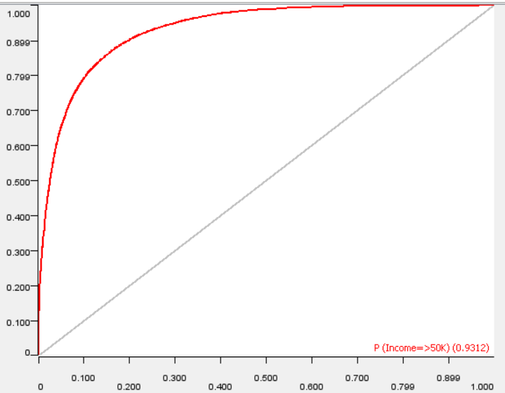
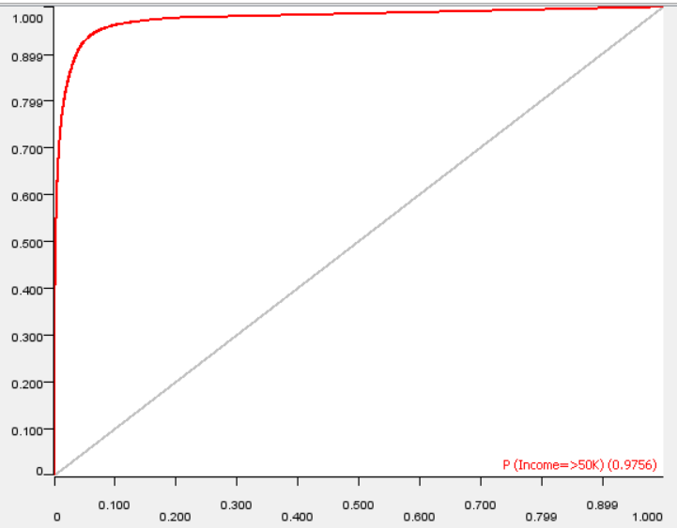
APENDIX (Cont.) ROC Curves (CONT.) (Q's 10.2, 11.3, 12.4):
Single Tree Model
Random Forrest Model

Slide 20




Appendix (cont.) Confusion tables (q10.2, 11.3, 12.4)
Single Tree:
Random Forest:
Naïve Bayes:
Logistic:

Slide 21
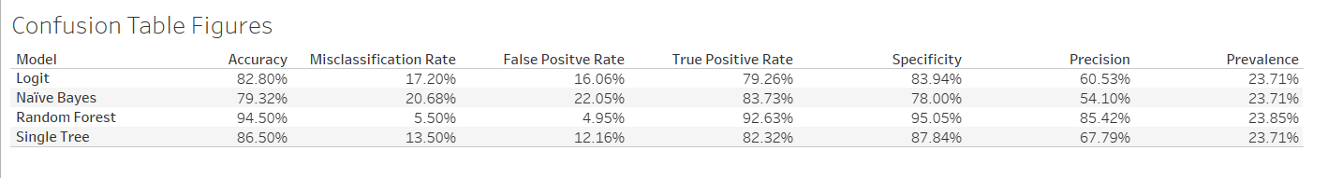
APENDIX (Cont.) Confusion Table Figures (Q's 10.3, 11.4, 12.5):

Slide 22
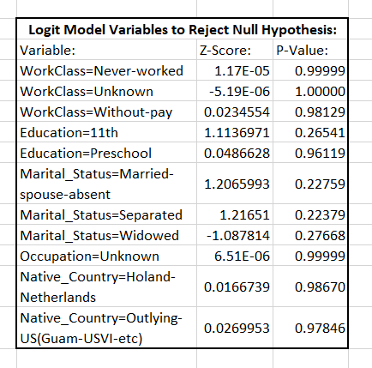
APENDIX (Cont.) Logit model coefficients Where NULL hypothesis Can be rejected (Q11.2):

Slide 23
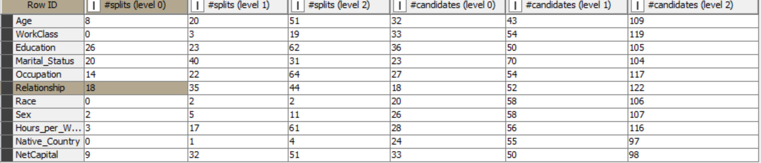
Appendix (ConT) variables useful for decision (q12.2):
Factors | Ratio
Age | 25
WorkClass | 0
Education | 72.22222
Marital_Status | 86.95652
Occupation | 51.85185
Relationship | 100
Race | 0
Sex | 7.692308
Hours_per_Week | 10.71429
Native_Country | 0
NetCapital | 27.27273
Ratio = #splits (level0)/#candidates(level0)
Chose the four highest: education, marital status, occupation, and relationship

Slide 24
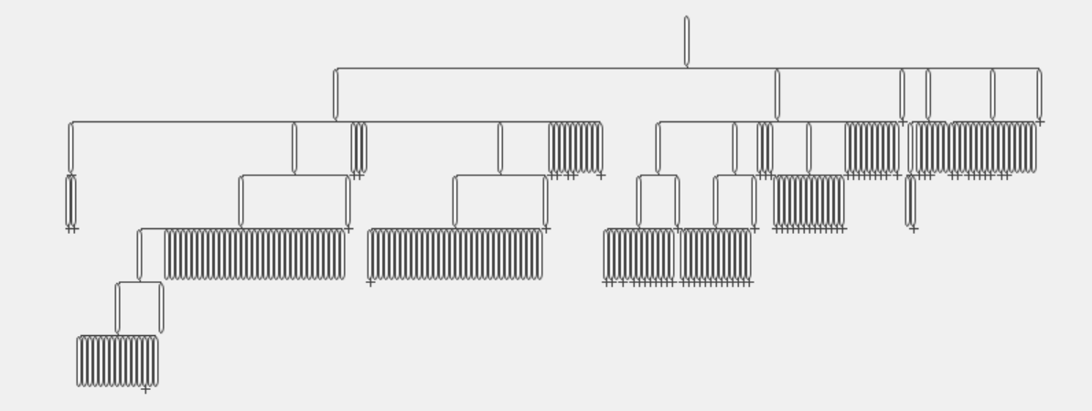
Appendix (cont.) plot of decision tree (q12.3)

Slide 25
Appendix (conT.) Why we chose random forest (q13.1):
Compared to the other models, the Random Forest has the:
Highest: accuracy, true positive rate, specificity, precision, and prevalence
Lowest: misclassification rate and false positive rate

